Slide 1
Ethics in Information Technology
Chapter 1
An Overview of Ethics
George W. Reynolds

Slide 2
Learning Objectives, Part 1
What is ethics?
What trends have increased the likelihood of unethical behavior?
What is corporate social responsibility, and why is fostering good business ethics important?

Slide 3
Learning Objectives, Part 2
What measures can organizations take to improve their business ethics?
How can you include ethical considerations in your decision making?
What trends have increased the risk that information technology will be used in an unethical manner?

Slide 4
What is Ethics?
Ethics: A code of behavior defined by the group to which an individual belongs
Morals: Personal principles upon which an individual bases his or her decisions about what is right and what is wrong
Virtue: A habit that inclines people to do what is acceptable
Vice: A habit of unacceptable behavior

Slide 5
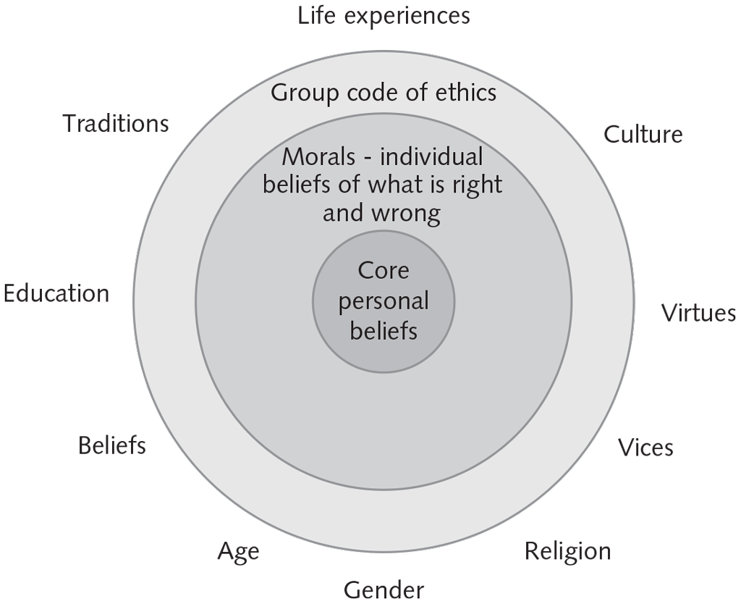
The Relationship Between Ethics and Morals

Slide 6
Integrity
Acting in accordance with a personal code of principles
Extending the same respect and consideration that one expects to receive from others
Applying the same moral codes in all situations
Consistency can be difficult to achieve in situations that conflict with one’s moral standards.
Inconsistency also occurs if one applies moral standards differently depending on the situation or people involved.

Slide 7
Difference Between Morals, Ethics, and Laws
Morals | Ethics | Law
Personal principles an individual uses to determine what is right and what is wrong Moral acts conform to what an individual believes to be the right thing to do | Code of behavior that is defined by the group to which an individual belongs | System of rules, enforced by a set of institutions, that tells us what we can and cannot do Legal acts are acts that conform to the law

Slide 8
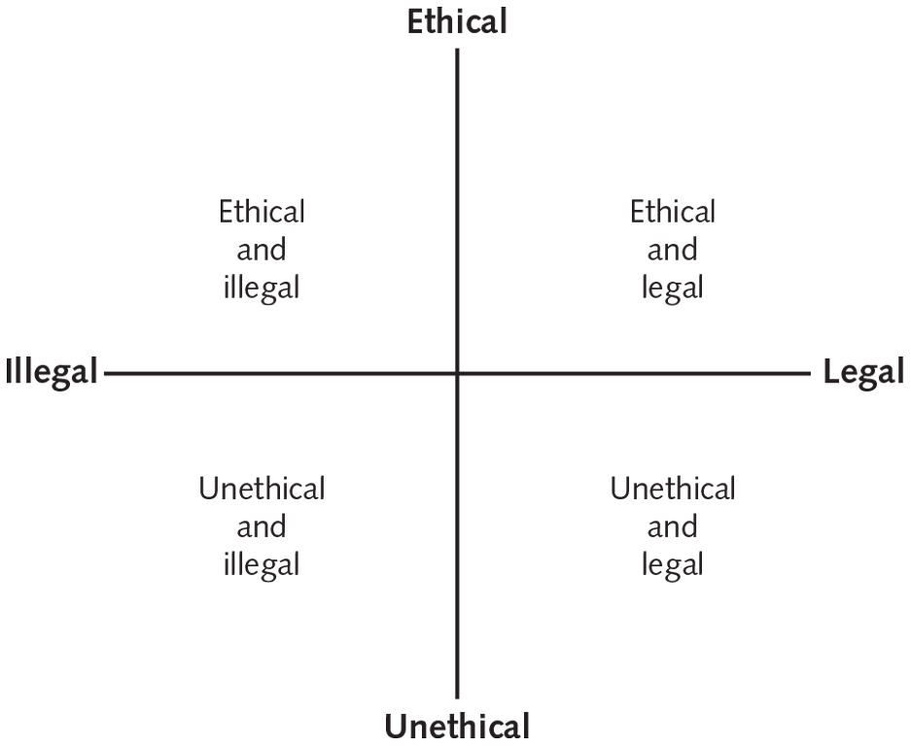
Legal versus Ethical

Slide 9
Ethics in the Business World
Trends that have increased the risk of unethical behavior:
More complex work environments spanning diverse cultures make it more difficult to apply principles and codes of ethics consistently.
Today’s challenging economic climate has increased the pressure on organizations to maintain revenue and profits.
Heightened vigilance by employees, shareholders, and regulatory agencies has increased the risk of financial loss and lawsuits for businesses that act unethically.

Slide 10
Bathsheba Syndrome
Term used to describe the moral corruption of those in power
Refers to the biblical story of King David, who became corrupted by his power and success
Moral corruption of people in power is often facilitated by a tendency for people to look the other way when their leaders behave inappropriately

Slide 11
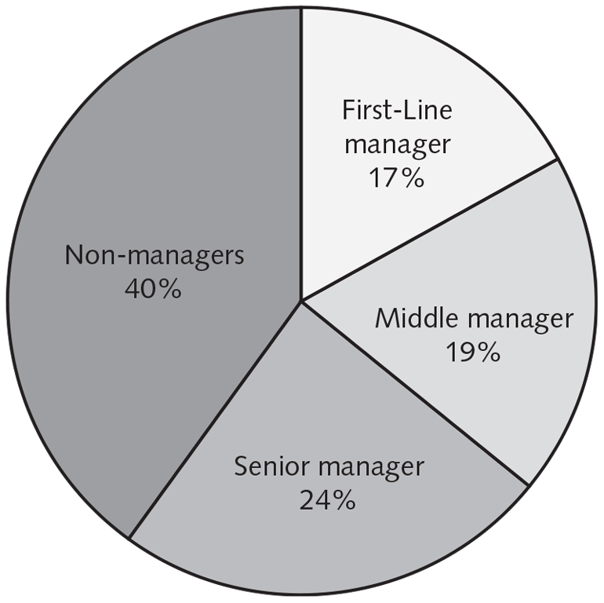
Who Is Responsible for Instances of Misconduct?

Slide 12
Corporate Social Responsibility (CSR)
Organization takes responsibility for the impact of its actions on:
Shareholders
Consumers
Employees
Community
Environment
Suppliers
Supply chain sustainability: A component of CSR focused on developing and maintaining a supply chain that meets the needs of the present without compromising the ability of future generations to meet their needs

Slide 13
Reasons to Foster Corporate Social Responsibility and Good Business Ethics
Gain the goodwill of the community
Create an organization that operates consistently
Foster good business practices
Protect the organization and its employees from legal action
Avoid unfavorable publicity

Slide 14
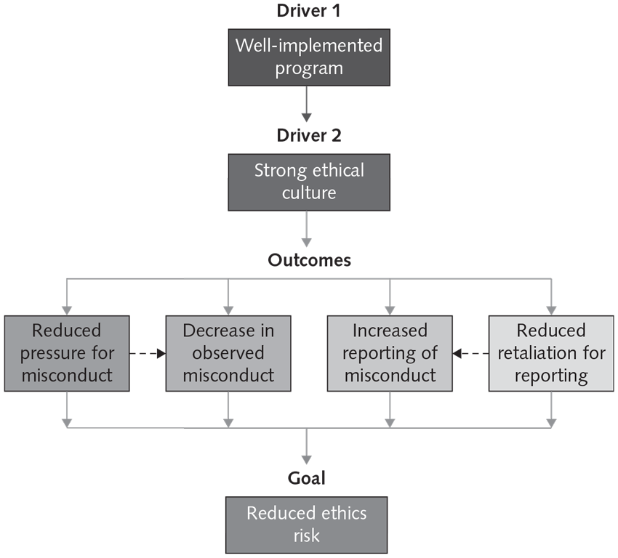
Reducing the Risk of Unethical Behavior

Slide 15
Characteristics of a Successful Ethics Program
Employees are willing to seek advice about ethics-related issues.
Employees feel prepared to handle situations that could lead to misconduct.
Employees are rewarded for ethical behavior.
The organization does not reward success obtained through questionable means.
Employees feel positively about their company.

Slide 16
Corporate Ethics Officer
Also called a corporate compliance officer
Provides an organization with vision and leadership in the area of business conduct
Ideally a senior-level manager who reports directly to the CEO
Responsibilities:
Ensuring compliance with ethical procedures
Creating and maintaining the ethics culture envisioned by the highest level of corporate authority
Serving as the key contact person for ethics issues

Slide 17
Ethical Standards Set by Board of Directors
Conduct themselves according to the highest standards of personal and professional integrity
Set the standard for company-wide ethical conduct
Ensure compliance with laws and regulations
Create an environment in which employees can:
Seek advice about business conduct
Raise issues
Report misconduct

Slide 18
Corporate Code of Ethics
A code of ethics:
Highlights an organization’s key ethical issues
Identifies the overarching values and principles important to the organization and its decision making
Organizational code of ethics should:
Apply to directors, officers, and employees
Focus employees on areas of ethical risk
Offer guidance to help employees recognize and deal with ethical issues
Provide mechanisms for reporting unethical conduct
Foster a culture of honesty and accountability

Slide 19
Social Audit
Organization reviews its ethical and social responsibility goals, and communicates its goals for the upcoming year.
Information is shared with:
Employees
Investors
Market analysts
Customers
Suppliers
Government agencies
Community

Slide 20
Ethics Training for Employees
A comprehensive ethics education program:
Encourages employees to act ethically
Shows employees examples of how to apply the code of ethics in real life
Goals of ethics training:
Encourage employees to report any misconduct
Show employees effective ways of reporting incidents
Reassure employees that such feedback will be acted on and that they will not be subjected to retaliation

Slide 21
Ethical Criteria in Employee Appraisals
Treating others fairly and with respect
Operating effectively in a multicultural environment
Accepting personal accountability for meeting business needs
Continually developing others and themselves
Operating openly and honestly with suppliers, customers, and other employees

Slide 22
Manager’s Checklist for Establishing an Ethical Work Environment
QUESTION | YES | NO
Does your organization have a code of ethics? Do employees know how and to whom to report any infractions of the code of ethics? Do employees feel that they can report violations of the code of ethics safely and without fear of retaliation? Do employees feel that action will be taken against those who violate the code of ethics? Do senior managers set an example by communicating the code of ethics and using it in their own decision making? Do managers evaluate and provide feedback to employees on how they operate with respect to the values and principles in the code of ethics? Are employees aware of sanctions for breaching the code of ethics? Do employees use the code of ethics in their decision making?

Slide 23
Five-Step Ethical Decision-Making Process
Develop a problem statement
A clear, concise description of the issue
Don’t make assumptions; verify “facts”
Identify alternatives
Enlist help of others
Choose alternative
Defensible and consistent; consider impact on others
Implement decision
Transition plan
Evaluate results
Poor alternative?
Bad implementation?

Slide 24
Concerns About the Ethical Use of Information Technology
Surveillance of citizens by governments
Email and Internet access monitoring at work
Music and movies downloaded in violation of copyright laws
Unsolicited email and text messages
Identify theft by hackers
Plagiarism by students
Cookies and spyware used to track users’ online purchases and activities

Slide 25
Summary, Part 1
What is ethics?
Ethics: A code of behavior defined by the group to which one belongs
Morals: Personal principles upon which an individual bases decisions about right and wrong
A person who acts with integrity acts in accordance with a personal code of principles.
Law: A system of rules that tells us what we can and cannot do
Code of ethics: States the principles and core values essential to one’s work
An activity may be legal but still not be ethical.

Slide 26
Summary, Part 2
What trends have increased the likelihood of unethical behavior?
More complex work environments make it more difficult to apply principles and codes of ethics consistently.
Organizations may resort to unethical behavior to maintain profits in an uncertain economic climate.
Highly successful individuals may fail to act in morally appropriate ways.

Slide 27
Summary, Part 3
What is corporate social responsibility (CSR), and why is fostering good business ethics important?
CSR: An organization takes responsibility for the impact of its actions
Supply chain sustainability: Meets current needs without compromising the ability of future generations to meet their needs
Reasons to foster CSR and good business ethics:
Gain the goodwill of the community
Create an organization that operates consistently
Foster good business practices
Protect the organization and employees from legal action
Avoid unfavorable publicity

Slide 28
Summary, Part 4
What measures can organizations take to improve their business ethics?
Appoint a corporate ethics officer.
Require the board of directors to set and model high ethical standards.
Establish a corporate code of ethics.
Conduct social audits.
Require employees to take ethics training.
Include ethical criteria in employee appraisals.
Create and ethical work environment.

Slide 29
Summary, Part 5
How can you include ethical considerations in your decision making?
Use a five-step model for decision making:
Define the problem
Identify alternatives
Choose an alternative
Implement the decision
Monitor the results
Incorporate ethical considerations into decision making:
Weigh laws, guidelines, and principals.
Consider the impact of the decision.

Slide 30
Summary, Part 6
What trends have increased the risk that information technology will be used in an unethical manner?
The growth of the Internet and social networks
The ability to capture, store, and analyze vast amounts of personal data
A greater reliance on information systems in all aspects of life
The importance of ethics and human values has been underemphasized

